Slide 1
OPERATIONS DIVISION DASHBOARD
Visualising Data Analytics with Strong Security Measure
11th December 2025

Slide 4
Power BI Dashboard: Driving Insights Securely
Visualizing data analytics with strong security measures
Notes:
---

Slide 5
Introduction to Power BI
Notes:
What is Power BI?

Slide 6

What is Power BI?
Transforming Data into Insights
  Power BI converts raw data into interactive dashboards and reports for clear business insights.
Real-time Analytics
  The platform provides real-time analytics, enabling quick and accurate decision-making.
Data Integration Flexibility
  Power BI integrates with Excel, SQL, and cloud sources, offering scalability and flexibility.
Cloud Accessibility and Collaboration
  Cloud-based architecture supports access across devices and remote collaboration.
Notes:
Power BI is a business intelligence tool developed by Microsoft that enables organizations to transform raw data into interactive dashboards and insightful reports. It provides a platform for real-time analytics, allowing decision-makers to access and interpret data quickly and accurately. Power BI integrates seamlessly with various data sources, including Excel, SQL databases, and cloud services, ensuring flexibility and scalability for businesses of all sizes. Its cloud-based architecture ensures accessibility across devices, enabling users to view and interact with dashboards from desktops, tablets, or smartphones. This capability supports remote work and collaboration, which is increasingly important in modern business environments. Furthermore, Power BI offers advanced visualization options, making complex datasets easier to understand through charts, graphs, and interactive elements. By leveraging these features, organizations can make informed decisions, identify trends, and optimize operations efficiently.

Slide 7
Importance of the Dashboard
Notes:
Why This Dashboard Matters

Slide 8
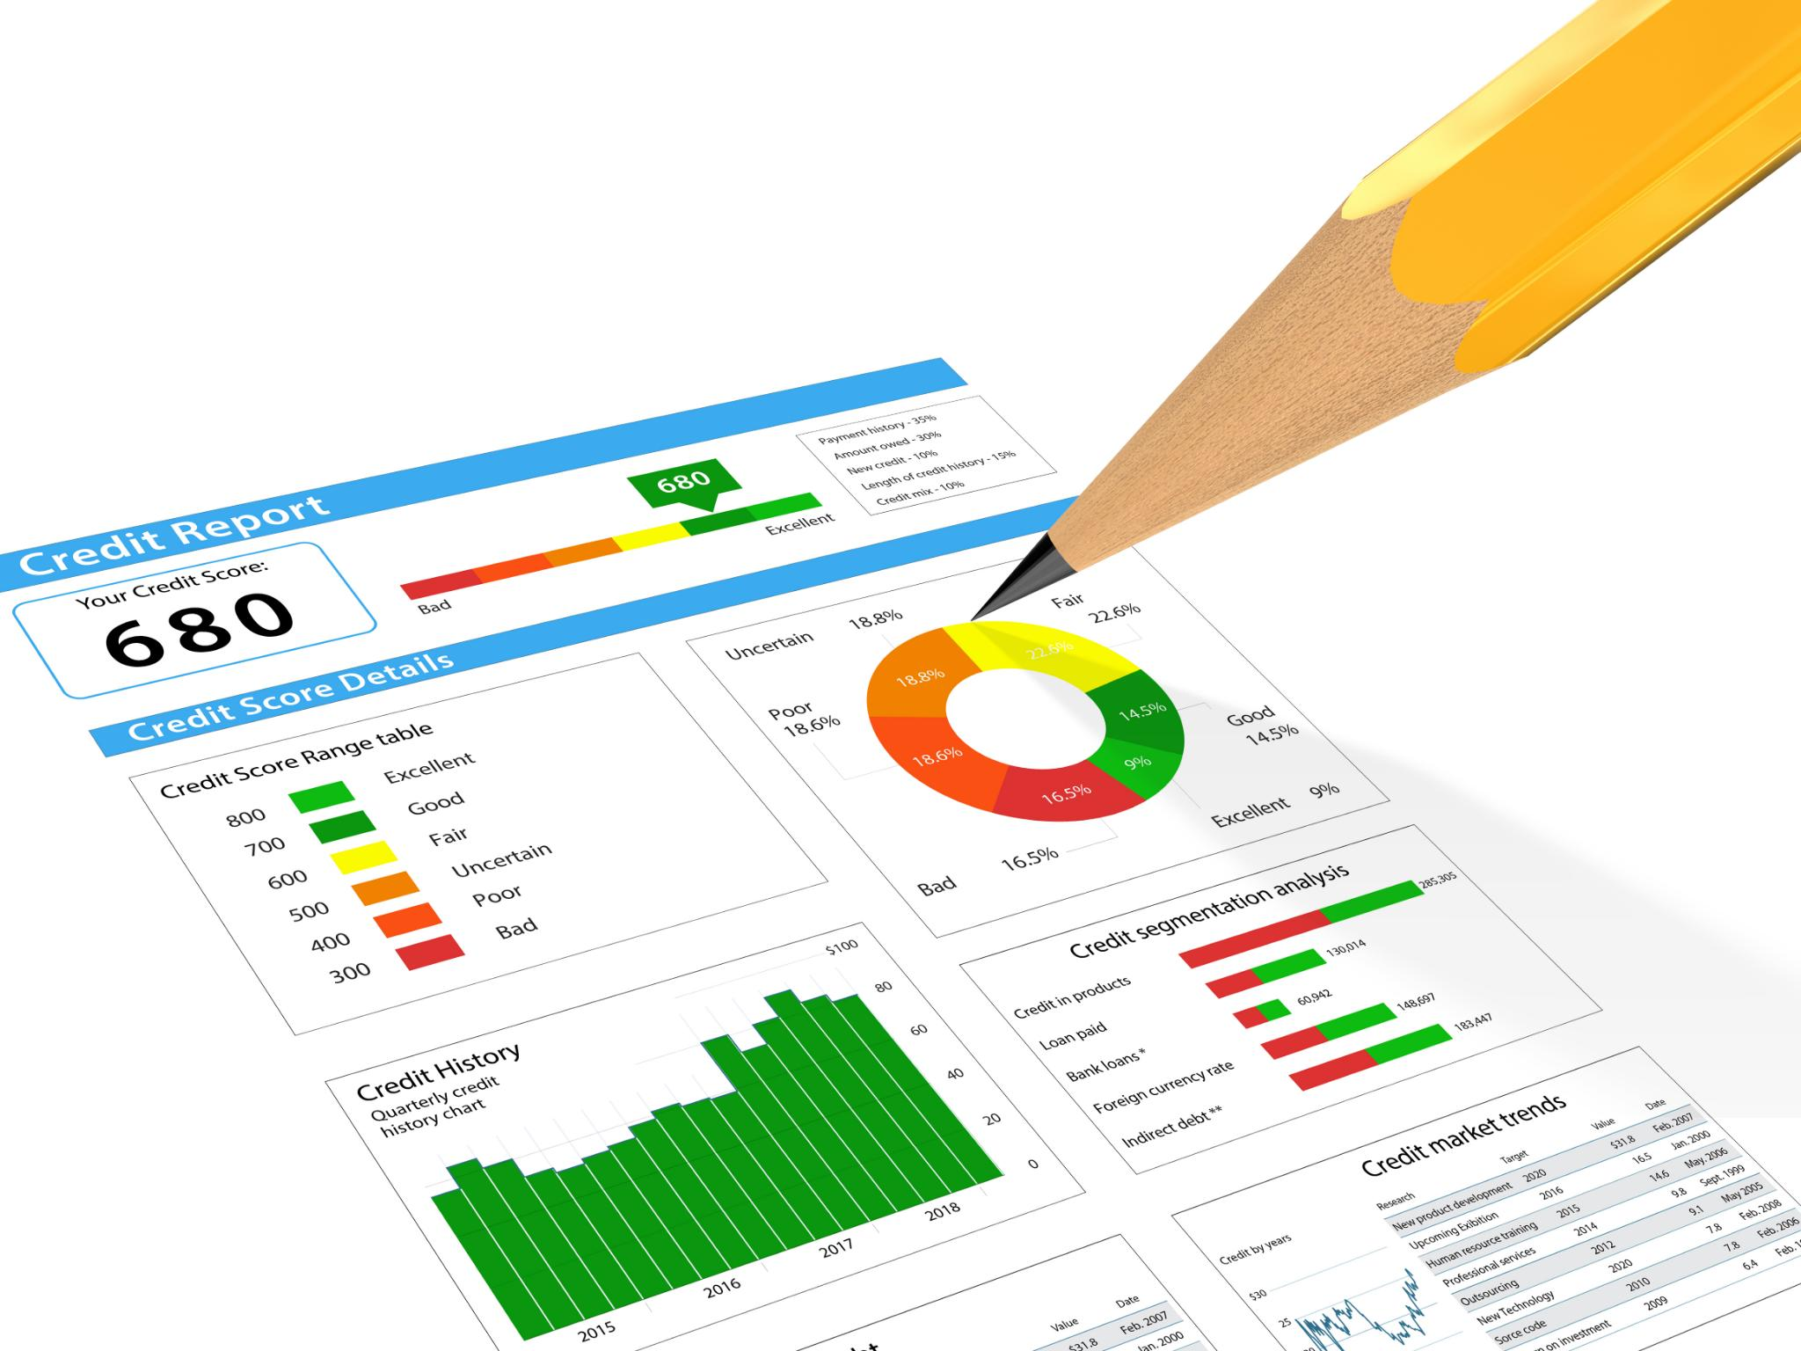
Why This Dashboard Matters
Centralized Data Visualization
  The dashboard consolidates multiple data sources into one platform, reducing manual effort and errors.
Faster Data-Driven Decisions
  Clear presentation of KPIs and trends empowers stakeholders to make quicker, informed decisions.
Operational Efficiency and Automation
  Automating reporting saves resources and ensures decision-makers access current, accurate data.
Strategic Alignment and Accountability
  The dashboard helps align business strategies with real-time metrics, promoting transparency and accountability.
Notes:
The dashboard you created serves as a centralized hub for data visualization, combining multiple sources into a single, cohesive platform. This consolidation eliminates the need for manual data gathering and reporting, significantly reducing errors and saving time. By presenting key performance indicators (KPIs) and trends in an easily digestible format, the dashboard empowers stakeholders to make faster, data-driven decisions. Actionable insights derived from the dashboard can highlight areas of improvement, identify growth opportunities, and monitor progress toward strategic goals. Additionally, the dashboard enhances operational efficiency by automating reporting processes, which traditionally consume significant resources. This automation not only improves accuracy but also ensures that decision-makers have access to the most current data at all times. Ultimately, the dashboard is a critical tool for aligning business strategies with real-time performance metrics, fostering a culture of transparency and accountability.

Slide 9
Security and Compliance
Notes:
Security & Compliance

Slide 10

Security & Compliance
Robust Security Framework
  Power BI uses Microsoft Azure’s security framework to protect sensitive data with enterprise-grade measures.
Role-Based Access Control
  Access to data is restricted to authorized users through role-based control, minimizing unauthorized access risks.
Data Encryption
  Data is encrypted during transmission and at rest to prevent breaches and ensure confidentiality.
Compliance and Monitoring
  Power BI complies with global standards like GDPR and provides audit logs for tracking user activity and accountability.
Notes:
Power BI is built on Microsoft Azure's robust security framework, ensuring enterprise-grade protection for sensitive data. It employs role-based access control, which restricts data visibility to authorized users only, thereby minimizing the risk of unauthorized access. Data is encrypted both in transit and at rest, safeguarding information from potential breaches during transmission and storage. Power BI also adheres to global compliance standards, including GDPR, which is essential for organizations operating in regulated industries. These security measures provide confidence that confidential business data remains protected while enabling seamless collaboration. Furthermore, Power BI offers audit logs and monitoring tools, allowing administrators to track user activity and maintain accountability. By leveraging these features, organizations can ensure that their data analytics processes are not only efficient but also secure and compliant with industry regulations.

Slide 11
Strategic Benefits of Power BI
Notes:
Why Power BI is Important for Us

Slide 12
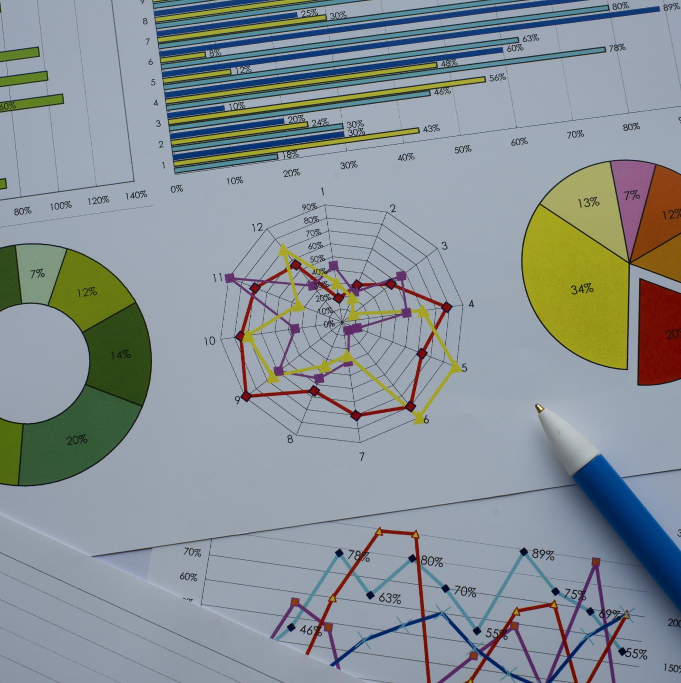
Why Power BI is Important for Us
Scalability for Growth
  Power BI handles large complex datasets efficiently, supporting growing business data needs without performance loss.
Enhanced Collaboration
  Secure sharing of reports and dashboards enables teamwork and informed decision-making within organizations.
Cost-Effective Solution
  Power BI reduces overhead by consolidating reporting tools, simplifying analytics and lowering costs.
Advanced Analytics Features
  Supports AI-driven insights, predictive analytics, and automated alerts to enhance business decision-making.
Notes:
Power BI offers several strategic advantages that make it an essential tool for modern businesses. Its scalability ensures that organizations can handle large and complex datasets without compromising performance, making it suitable for growing enterprises. Collaboration is another key benefit, as Power BI enables secure sharing of dashboards and reports within organizational boundaries, fostering teamwork and informed decision-making. Additionally, Power BI is cost-effective compared to maintaining multiple reporting tools, reducing overhead and simplifying the analytics ecosystem. The platform also supports advanced features such as AI-driven insights, predictive analytics, and automated alerts, which can further enhance decision-making capabilities. By adopting Power BI, organizations position themselves to leverage data as a strategic asset, driving efficiency, innovation, and competitive advantage in their respective markets.

Slide 13
Next Steps
Notes:
Call to Action, Dashboard Screenshot Placeholder

Slide 14

Call to Action
Approve Power BI Integration
  Authorize continued use and integration of Power BI to streamline data processes and enhance collaboration.
Explore Advanced Analytics
  Utilize AI-driven analytics and automated alerts to optimize operations and gain a competitive edge.
Invest in Training and Governance
  Provide training and enforce governance to maximize platform capabilities while ensuring security and compliance.
Build Data-Driven Culture
  Foster a data-driven culture supporting strategic objectives and long-term organizational growth.
Notes:
To fully capitalize on the benefits of Power BI, it is recommended to approve its continued use and integration into the organization's reporting and analytics framework. This approval will enable teams to streamline data processes, enhance collaboration, and make informed decisions based on real-time insights. Additionally, exploring advanced features such as AI-driven analytics and automated alerts can further optimize business operations and provide a competitive edge. Investing in training and governance will ensure that users can maximize the platform's capabilities while maintaining security and compliance. By taking these steps, the organization can establish a robust, data-driven culture that supports strategic objectives and long-term growth.

Slide 15

Dashboard Screenshot Placeholder
Dashboard Layout Overview
  The dashboard provides an organized layout for easy navigation and quick data insights.
Data Visualization Features
  Includes various charts and graphs to visually represent key performance indicators and trends.
Functionality and Usability
  Designed for intuitive use, enabling stakeholders to interact and gain insights efficiently.
Notes:
Insert screenshot from Power BI link here: https://app.powerbi.com/links/f0TfPPPzah?ctid=d703bd9e-2913-4bf9-8dd7-49ce1b18bd11&pbi_source=linkShare&bookmarkGuid=639a9718-7069-4e21-b610-ae6a7414a127. This visual representation will provide stakeholders with a clear understanding of the dashboard's layout, features, and functionality, reinforcing its value and usability.

